Slide 1
Vision for Volunteering
Introduction
Notes:
9.30-9.45
Hello and welcome

Slide 2
What’s coming up!
An introduction to the Vision for Volunteering: what, why and how?
The Vision for Volunteering themes: what they are and what they mean
Notes:
9.30-9.45
- Talk through agenda

Slide 3
Discussion Question:
What is one of the most significant volunteering experiences you have ever had?
What made it so significant?
Notes:
9.30-9.45
Launch zoom poll

Slide 4
Changes We are Seeing – Need for the Vision
Volunteering currently isn’t accessible or equally enjoyable for everyone.
We saw huge changes happen for volunteers and their activities during the Covid-19 pandemic, but not all of this was positive or permanent.
We also see changing patterns in who volunteers, how and in what activities and roles.
Notes:
9.30-9.45
Talks through these points:
More than 350 from over 300 organisations helped design the Vision for Volunteering
In late 2021, a steering group ran 14 workshops, carried out numerous interviews and received 43 written submissions from volunteers, volunteer-involving organisations and other stakeholders
The Vision for Volunteering was launched in May 2021

Slide 5
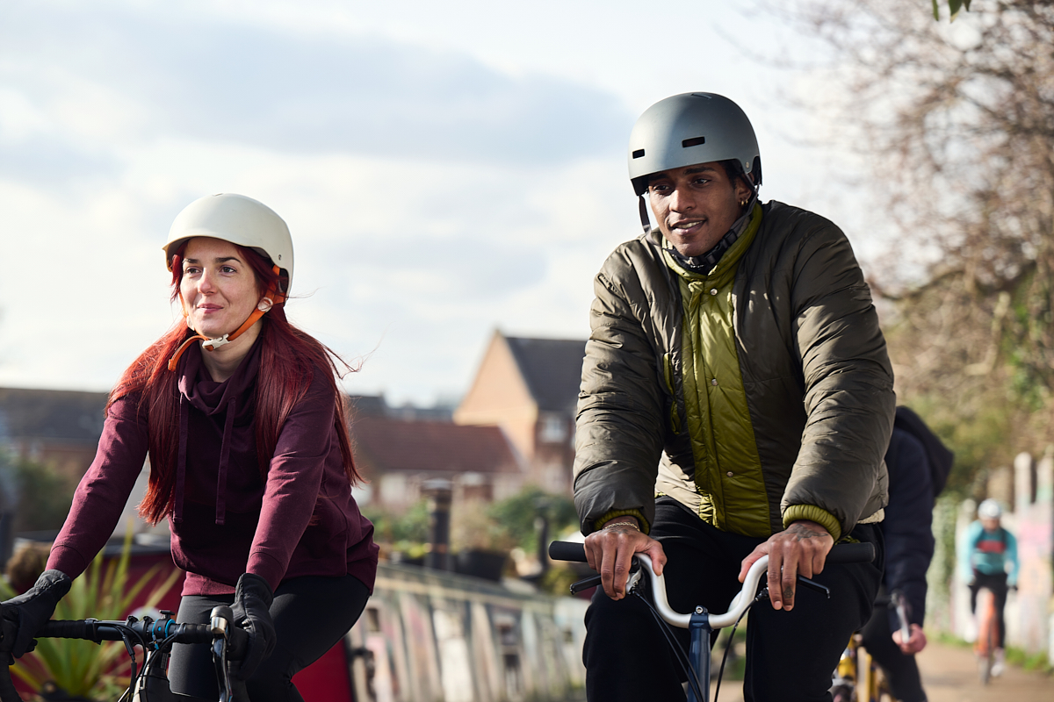
The Vision is a ten-year collaborative project designed to create a better future for volunteering
National Council for Voluntary Organisations (NCVO)
Association of Volunteer Managers (AVM)
National Association for Voluntary and Community Action (NAVCA)
Volunteering Matters
Sport England
Department for Culture, Media and Sport
Muslim Charities Forum
Notes:
9.30-9.45

Slide 6
What IS the Vision for Volunteering?
A view of what volunteering could look like by 2032
A collaborative, grassroots-focused project designed to help you think about what works and doesn't work for you
What ISN'T the Vision for Volunteering?
A rigid structure to aspire to
Something that is being imposed upon you
Notes:
9.30-9.45

Slide 7
The Vision for Volunteering tackles five key themes:
Awareness and Appreciation
Power
Equity and Inclusion
Collaboration
Experimentation
Notes:
9.30-9.45
References these questions when talking through the Vision theme slides:
What do volunteers need now, and during the next 10 years, in order to make their most effective contributions?
How do we capture new practice and technology and harness it to create a better future for volunteering?
How can we let go of practices that no longer serve us and tackle some of volunteering’s most
long-standing inequalities?
THINK ABOUT: how do these themes resonate with you? How can you make changes in these areas? What are the barriers to these changes?

Slide 8
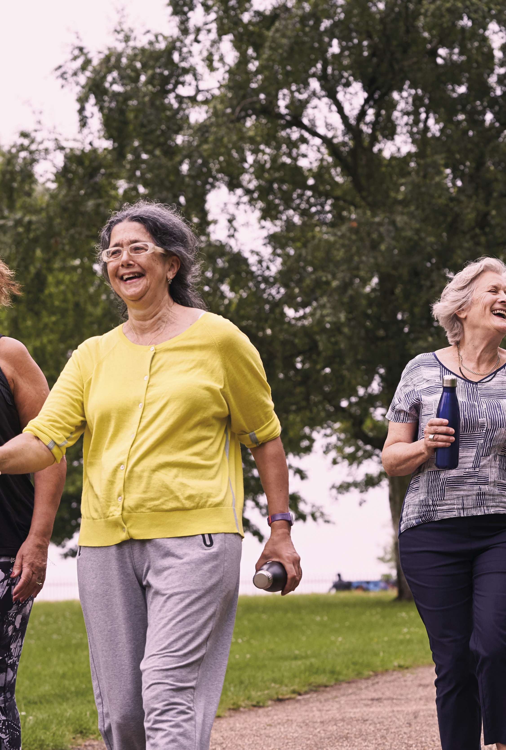
Awareness and Appreciation
A future where a culture of volunteering is part of everyone's life and volunteer roles are given the recognition they deserve.
Notes:
9.30-9.45
on the theme slides- talk through the how, why, what statements in the context of each theme
Volunteering is a continuum of involvement and participation, from occasional to regular and from highly organised to informal. We should not expect that volunteers will stay with an organisation indefinitely. It needs to be easy to move to other volunteering roles, to pause or stop volunteering, and to start again, whether because of what is happening in our lives, or because of changing needs and issues in society. To support this fluidity, organisational cultures must embrace sharing and flexibility, with volunteers moving between organisations and activities, to develop and try new things.
By 2032
Volunteering is something we all do across the different settings and stages of our lives. It has equal validity alongside public and private endeavours, and we are proud to talk about it.
Organisations involving volunteers understand how and when volunteers want to engage.
Volunteer voices are embedded in the leadership and design of volunteering initiatives, driving how they are involved.
Volunteering is appreciated by individuals, communities, organisations and policy makers as helping to enrich lives and enliven communities.
The appreciation and celebration of volunteering is supported by common metrics for measuring volunteering which have been adopted by central and local government, and organisations involving volunteers.

Slide 9
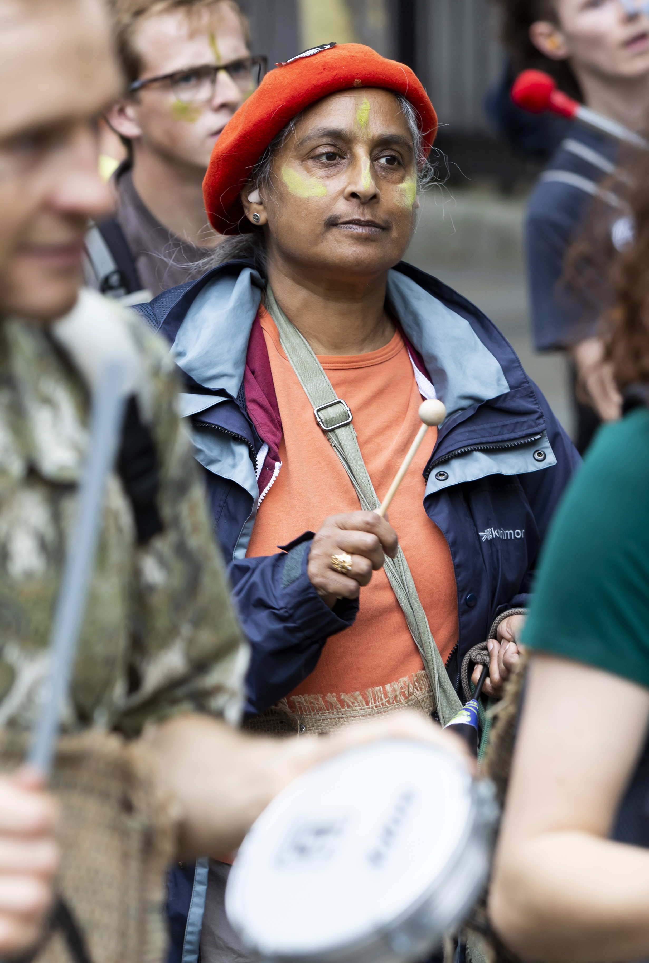
Power
A future where volunteers (and the communities they serve) lead on change that matters to them.
Notes:
Volunteers and the communities they serve have power and are leaders.
Everyday, volunteers make things happen. People come together in movements of support, action, solidarity and protest. Many of our organisations, charities and institutions were formed by volunteers.
Everyone can engage within their community, identifying what matters to them and building the future they want to see
People supporting volunteers work alongside them as equals, channelling their interests and passions and supporting them to make change
First-hand experience is valued and the focus is on people’s ability to make change, whatever their role. People are supported to move between roles - volunteering, paid work and accessing services
Decisions are made by those best placed to make them, not based on a hierarchy
We recognise who is missing in our volunteering spaces and have the confidence and ability to rectify this and redistribute power
People working alongside volunteers are accountable to communities as well as to government or funders. Our focus is on building equitable relationships and deep connections.
Emerging social movements, causes and campaigns are supported and recognised within a wider movement for change. They work alongside and positively disrupt more established organisations. Larger or better resourced organisations support and enable groups with fewer resources

Slide 10

Equity and Inclusion
A future where it’s easy for people to give their time and energy to the causes they care about, they feel welcomed, and the benefits are equally distributed.
Notes:
We want volunteering to be accessible and welcoming to everyone, everywhere, so that the benefits of volunteering - to individuals and communities - are equally distributed.
Currently, volunteering is not inclusive of all people and communities - both in terms of levels of participation and the volunteer’s experience of being involved.
Those from lower socio-economic groups are less likely to volunteer through organisations and groups than those from higher socio-economic groups. Younger, disabled, and volunteers with an ethnic minority background also report a less positive experience when volunteering through organisations and groups
We have built and continue to foster cultures that are inclusive of all who want to give their time, making sure volunteering can fit with people’s identity, background and life experience
By listening to people who experience exclusion from volunteering, organisations and groups remove barriers and provide additional support, to ensure that everyone who wants to can volunteer
We encourage people to raise concerns about discrimination or inequity, welcome it as an opportunity to improve, and effectively address issues
Those in powerful leadership and governance roles look and sound like the communities they serve, which increases legitimacy and trust
We consider who has relationships with those who are marginalised and collaborate with others to make sure everyone is included
Good data on volunteering demographics is consistently captured, shared and used to drive change
Those who support volunteers have the resources, networks, and time to learn and adapt in order to be more inclusive. We share our good practice.

Slide 11
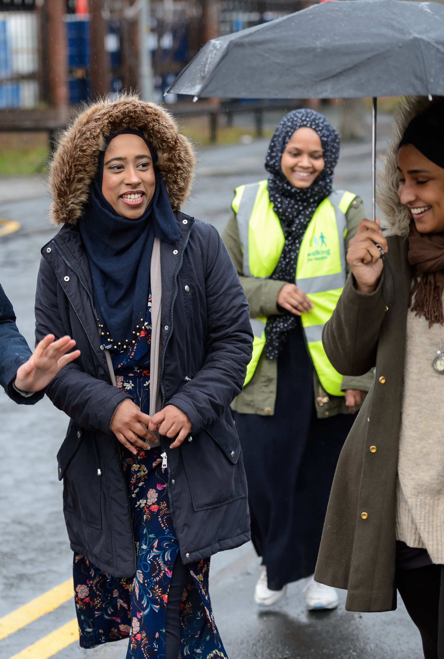
Collaboration
A future where collaboration is natural and spontaneous, where people do great stuff together because they want to.
Notes:
We should recognise the ability of communities to drive collaboration. We must value, and add value to, this collaboration. There should be a radical shift in emphasis towards building community-led coalitions of interest and collaborative activity, rather than creating top-down and imposed partnership working.
Organisations support and champion communities to drive their own collaborative activity and don’t feel the need to ‘own’ activity
Volunteers play an essential role in building seamless collaborations within and across all sectors
Collaboration nurtures and supports new people and organisations to engage in new projects
Moving between organisations and projects is normal and welcome – sharing of people, talent and connections is how we all work
We tackle the barriers that organisations can put up – we recruit, train and work with volunteers jointly wherever we can
Within an organisation or a movement, volunteers and paid staff collaborate well together - helping each other, learning from each other and recognising the value one another brings.

Slide 12
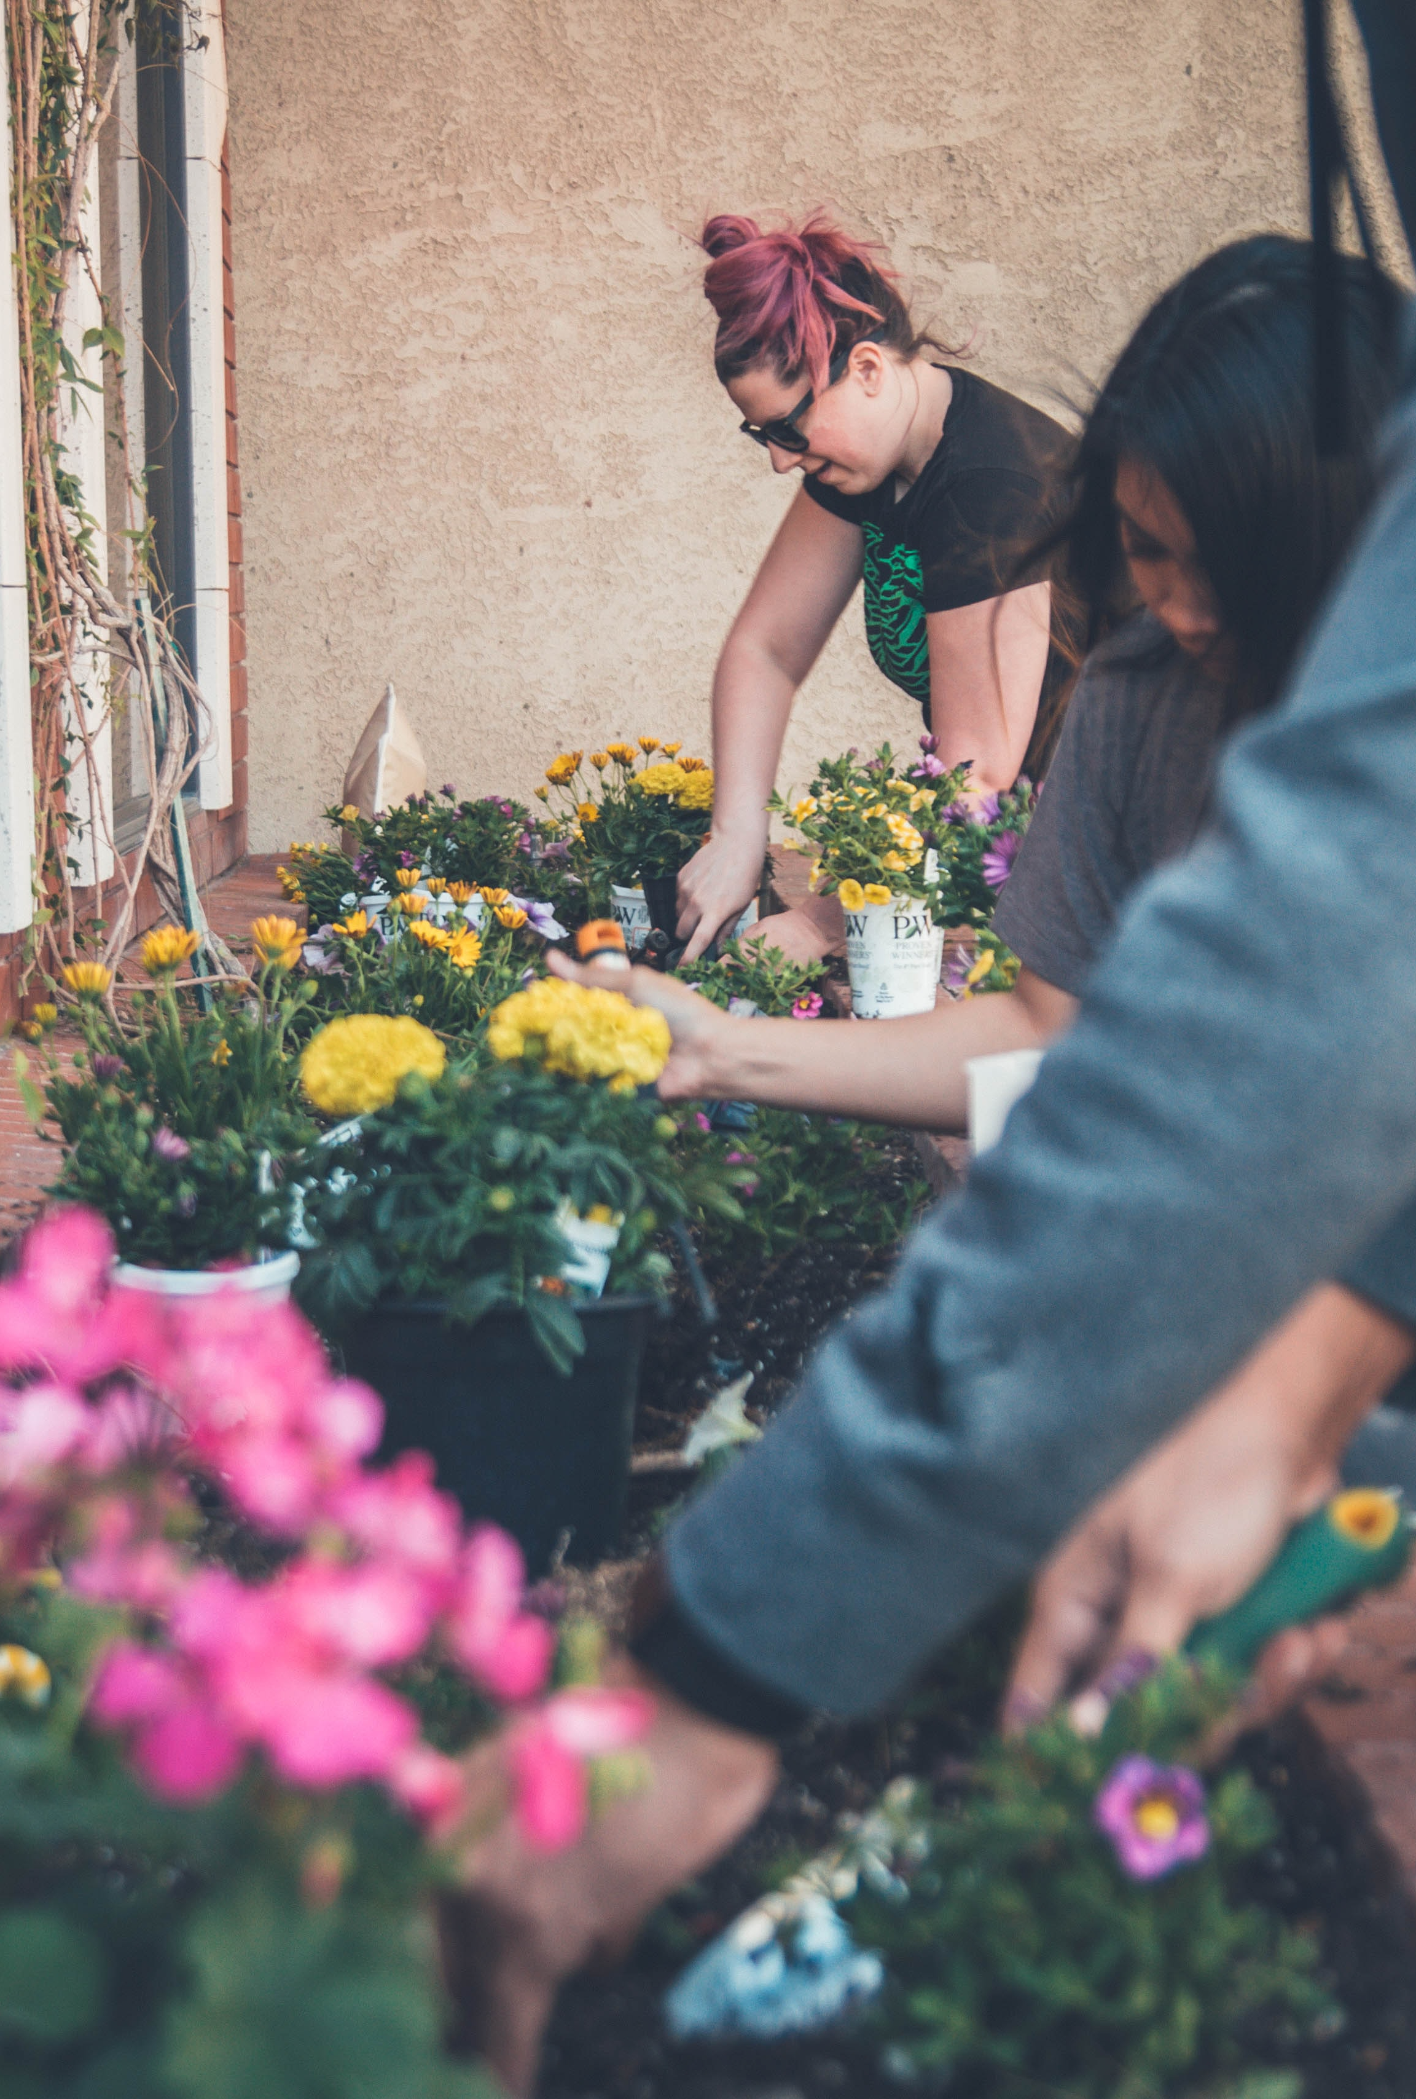
Experimentation
A future where communities aren't afraid to try new things to develop their own, innovative solutions to engaging and supporting volunteers.
Notes:
experimentation should become a natural part of volunteering, not a temporary bolt-on.
Experimentation is not reserved for times of crisis, but is incorporated into the way volunteering works day-to-day
Communities are supported to experiment and innovate to develop their own solutions
Those that create an enabling environment for volunteering - leaders, funders, trustees and government at all levels - support a culture of experimentation. This means that communities and organisations are trusted to design projects as they see fit, learn and adapt
Relationships are built on trust. We avoid overly bureaucratic systems, instead balancing change and flexibility with the need to protect people’s safety and wellbeing at all times
We embrace a genuine learning culture – seeking out and listening to those with expertise, wherever this lies, building on what works well, learning when things go wrong, and staying curious
We learn from and move on from approaches that are not working. We become less fearful of being seen to ‘fail’.

Slide 13
Living the Vision for Volunteering - Experimentation
Try, Test, Repeat!
Notes:
Think about small pledges
Think about what support is needed?? In the chat/ email

Slide 14
Discussion Questions:
What volunteering experiments could you run?
What barriers are you facing?
Notes:
Think about small pledges
Think about what support is needed?? In the chat/ email

Slide 15
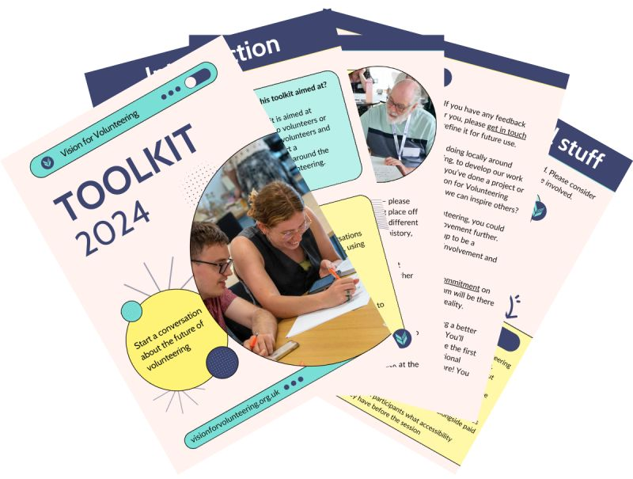
Toolkit

Slide 16

Vision Champions
Champion the Vision for Volunteering in your organisation or community. Help to build the movement and create a better future for volunteering.
Notes:
12:45 - close
What does a Champion do?
There are plenty of opportunities for Vision for Volunteering Champions to get involved and help to build the movement. You may wish to pick and choose those that feel right for you. These opportunities include, but are not limited to:
Championing our themes within your spaces - organisations, communities, groups, etc.
Encouraging your spaces to commit to Vision pledges and holding them accountable
Being mindful of the Vision themes in your work and/or volunteering
Attending events on our behalf
Speaking at events on our behalf
Sharing the Vision themes and aims with your colleagues and community
Holding the Vision accountable in being an example to others in the sector
Participating in focus groups, steering groups and making other contributions to the development of the Vision
Over to you - if you have ideas on how to help build the movement, we’d love to hear them!
Who can be a Champion?
Anyone within the volunteering space can sign up to be a Vision for Volunteering Champion.
From Volunteer Managers, to Volunteers, to Charity Leaders and much more - if you’re involved in volunteering, and are passionate about the Vision, this opportunity could be for you.

Slide 17
Questions?
Notes:
Questions?

Slide 18

What next?
Sign up to our mailing list: visionforvolunteering.org.uk/newsletter
Twitter: @VisionForVol
Instagram: @VisionForVolunteering
Facebook: facebook.com/visionforvolunteering
LinkedIn: linkedin.com/company/vision-for-volunteering
Get in touch: hello@visionforvolunteering.org.uk
Notes:
12.15-12.30
Note to facilitator:
Attendees may wish to use this time to fill in the feedback form now, or after the session- whichever they're most comfortable with
Talk through how attendees can get further involved, referencing our "join the movement" webpage: https://www.visionforvolunteering.org.uk/take-action
Talk through how we will be capturing insights from today's session, and how this will help shape the toolkits and further events post summer- and how they can hear updates on this and further opportunities to get involved
Reminding people and sharing links to our mailing list and VFV socials
Talk through follow up content we will be sharing after the call
Reminder to do screen shot photo of the group before we close, and encourage attendees to use their socials to talk about the event (see agenda)

Slide 19

Notes:
Feedback forms???

